Slide 1
Chapter 6 Marketing and Intermediaries
Simon Hudson

Slide 2
Topics Covered
Marketing communications
Branding
Advertising
Direct marketing
Intermediaries
Alliances

Slide 3
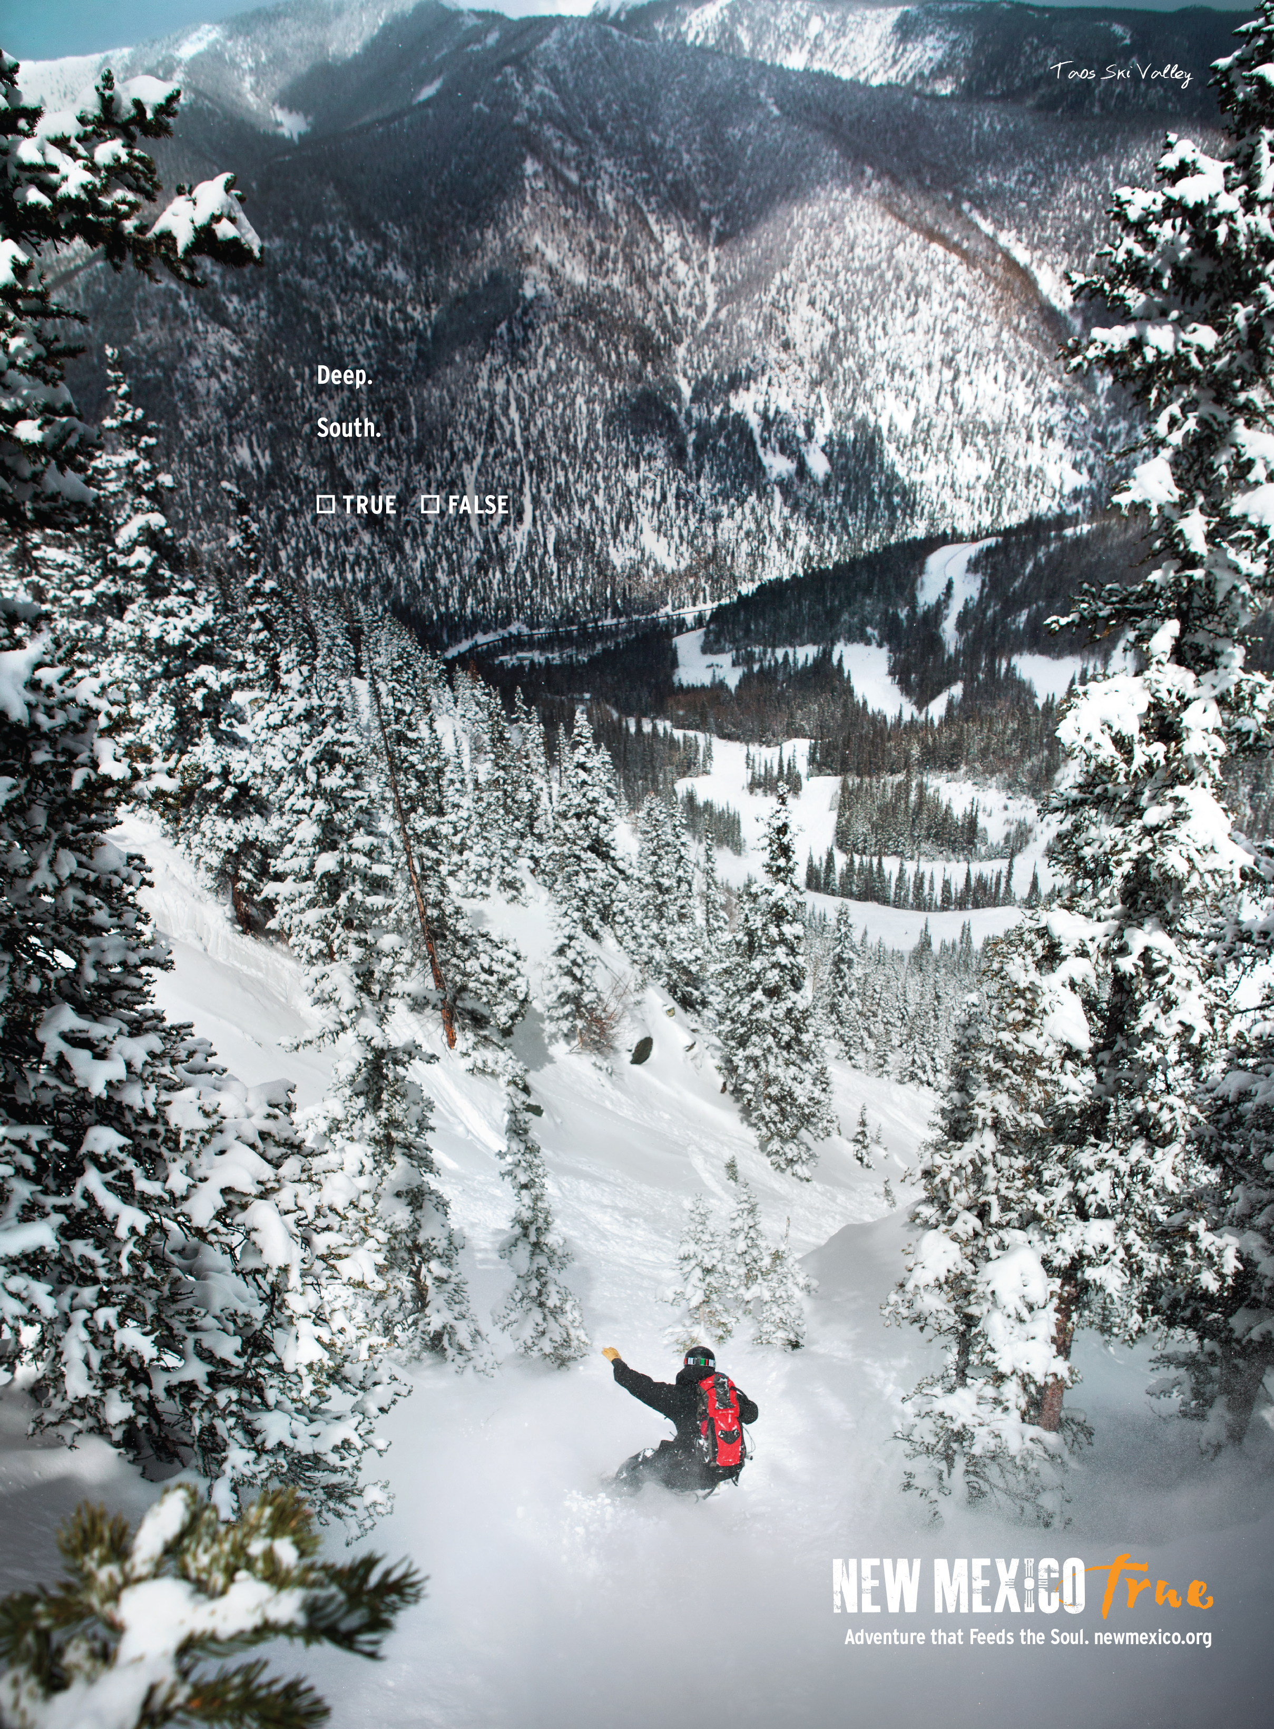
Spotlight: New Mexico True
New Mexico: a new winter sports wonderland
The creative campaign is being disseminated via multi media
Return on investment (ROI)

Slide 4
Marketing communications
Marketing mix
Promotion: a short-term activity, but considered at a strategic level it is a mid- and long-term investment
Integrated marketing communications (IMC)
Position of the organization in the distribution channel

Slide 5
The role of promotions in the marketing strategy

Slide 6
The promotional mix used in winter sport tourism
Promotional tool | Winter sport tourism application
Advertising | Television, newspapers, magazines, billboards, Internet, brochures, guidebooks
Sales promotion | Short-term incentives to induce purchase. Aimed at salespeople, distributors such as travel agents, and consumers. Can be joint promotions. Include merchandising and familiarization trips.
Public relations | All non-paid media exposure appearing as editorial coverage. Includes sponsorship of events and causes.
Personal selling | Meetings and workshops for intermediaries; telephone contact and travel agents for consumers
Word of mouth | Promotion by previous consumers to their social and professional contacts.
Direct marketing | Direct mail, telemarketing, and travel exhibitions
Internet marketing | Direct e-mail marketing, Internet advertising, social media, customer service, selling, and market research

Slide 7
Branding
An analysis of the current situation
Develop the brand identity
Communicate the vision and launch the brand
Evaluate the brand’s performance in the marketplace

Slide 8
Advertising
Influence the attitudes and behavior
confirming and reinforcing, creating new patterns of behaviors, or changing attitudes and behavior
The process of developing an advertising program

Slide 9
The process of developing an advertising program

Slide 10
Print advertisement for Stein Eriksen Lodge
in Deer Valley, Utah
One of Ski Utah’s creative print advertisements from 2014

Slide 11
Direct Marketing
A marketing system
Promotes products directly to the final consumer
Advantages of direct marketing
precision targeting; personalization; flexibility; privacy; measurability; low cost; detailed knowledge; fast or immediate
Direct response advertising
Sales promotion

Slide 12
Strategic considerations for the major forms of direct response advertising

Slide 13
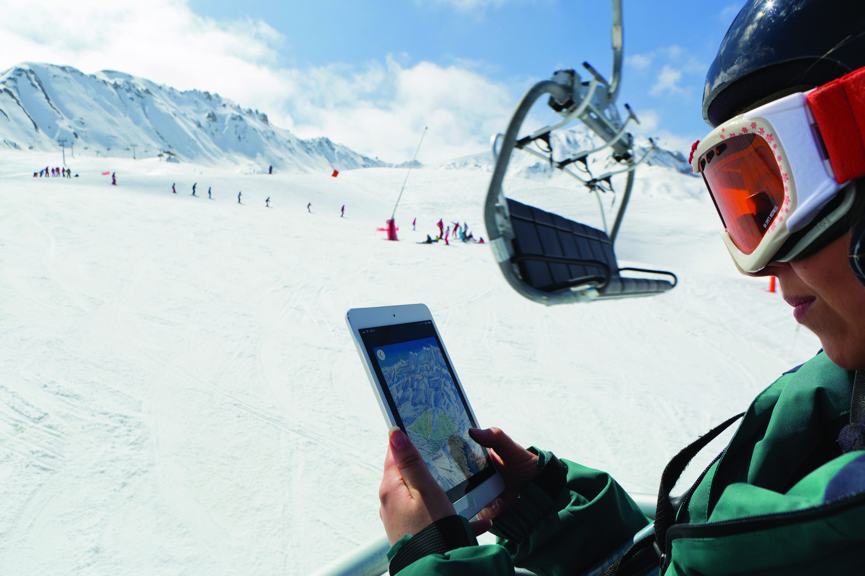
Profile: Snow Crystal
Crystal Ski Holidays: one of the foremost tour operators
Online pricing facility
iPads given to reps
Crystal Ski Explorer App

Slide 14
Intermediaries
Distribution channel
a direct distribution channel
an indirect channel
Marketing intermediaries are channels of distribution that include travel agents, tour operators, travel specialists and the Internet

Slide 15
U.K. share of the snow sports market by holiday type
Source: Adapted from Mintel, 2014, pp. 28

Slide 16
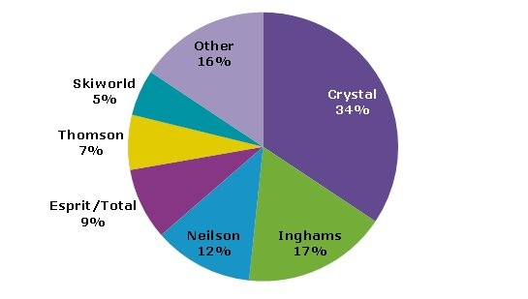
Market share of winter sport tour operators by brand, by number of holidaymakers
Source: Adapted from Mintel, 2014, pp. 32

Slide 17
Alliances
A partnership
Ski resorts collaborate to create a competitive advantage (British Columbia, Canada )
Resorts forming alliances with brands for mutual benefit

Slide 18
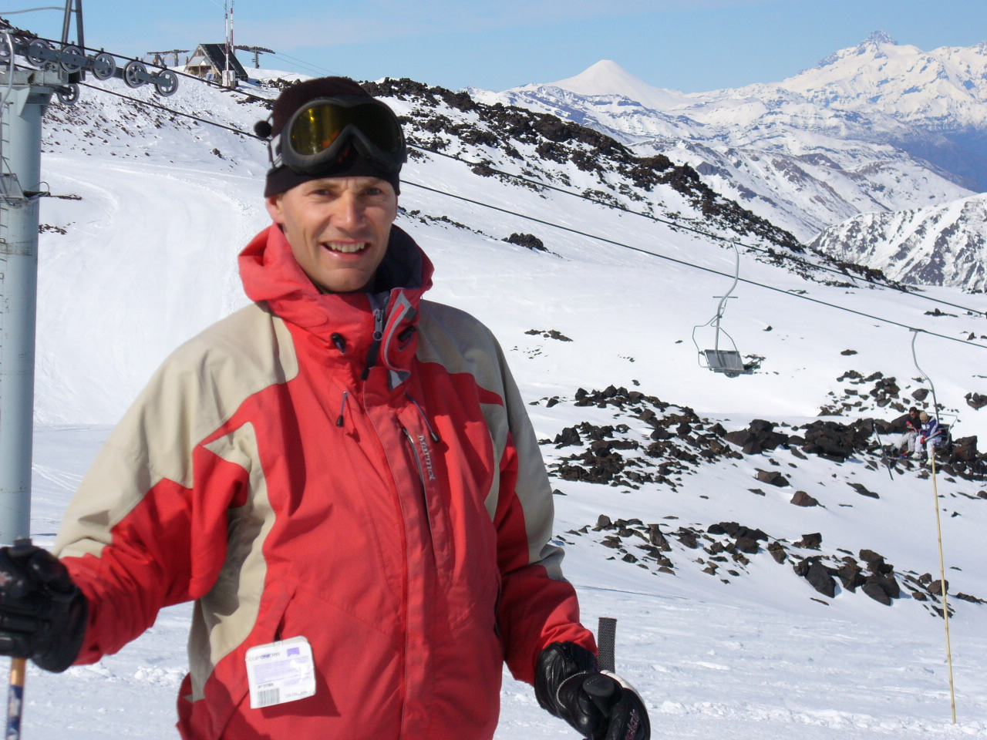
Case Study: Year round dream skiing
DreamSki: all-inclusive guided resort-based tour packages
Marketing: social media
Competition for DreamSki is limited due to the niche nature of the business.

